Slide 1

The Boundlessness of Measurement Error
Unlike confounding bias, which is more tightly bounded by than by Vanderweele and Ding’s (2017) E-value,
bias due to measurement error has no bounds,
robust methods and software are available to correct for this bias in exposures of interest and potential confounders, empirically eliminating the residual confounding issues
High quality validation and reliability data are available across a range of chronic disease risk factors, permitting empirical adjustment to eliminate this source of bias. This is the focus of this course: design of validation and reliability studies to then correct analyses for measurement error bias.
VanderWeele, Tyler J., and Peng Ding. 2017. “Sensitivity Analysis in Observational Research: Introducing the E-Value.” Annals of Internal Medicine (July 11). doi:10.7326/m16-2607.

Slide 2
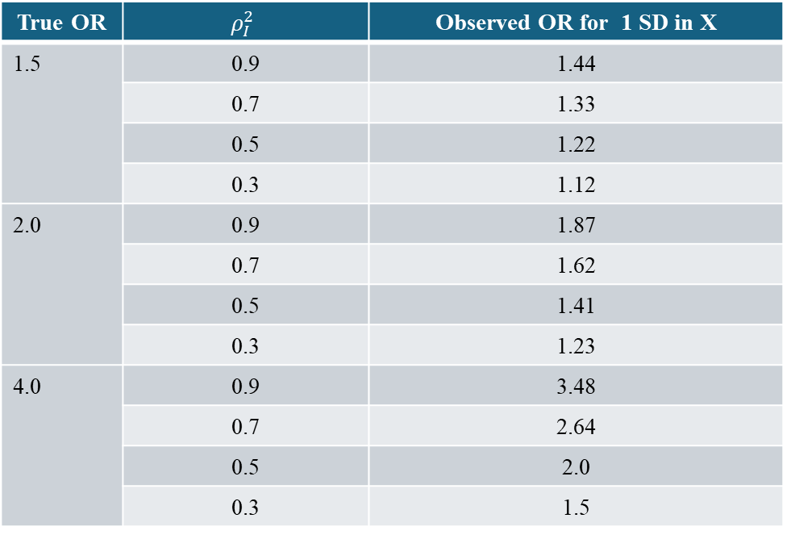
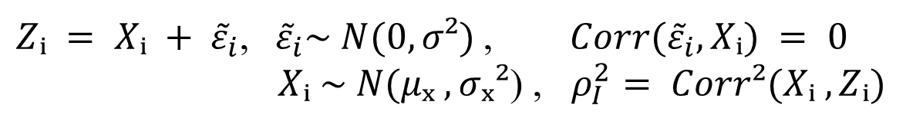
Bias in Point Estimate of Odds Ratio
The case of random measurement error
$Zᵢ = Xᵢ + {\tilde{ε}}_{i}$,${ \tilde{ε}}_{i}\sim N(0, σ²)$, $Corr({\tilde{ε}}_{i}, Xᵢ) = 0$
$Xᵢ \sim N(μₓ , σₓ²$) , $ρ_{I}^{2}= Corr²(Xᵢ , Zᵢ)$
observed gold standard
True OR | $$ρ_{I}^{2}$$ | Observed OR for 1 SD in X
1.5 | 0.9 | 1.44
 | 0.7 | 1.33
 | 0.5 | 1.22
 | 0.3 | 1.12
2.0 | 0.9 | 1.87
 | 0.7 | 1.62
 | 0.5 | 1.41
 | 0.3 | 1.23
4.0 | 0.9 | 3.48
 | 0.7 | 2.64
 | 0.5 | 2.0
 | 0.3 | 1.5
Armstrong BK, White E, Saracci R.
'Principles of Exposure Measurement
in Epidemiology'.
Oxford University Press Inc; 1992.
Yale School of Public Health

Slide 3
Common Approaches to the Measurement Error
Problem in Epidemiology
1. Sensitivity Analysis
Non-differential error bias toward the null - but not always
2. Validation of exposure measurement
Reporting a statistically significant association (through p-value testing) between true and observed does not imply no bias due to measurement error.
3. Quantitative correction of effect estimate
i. DESIGN: Main study/ reliability or validation study
ii. ANALYSIS: measurement error & misclassification methods

Slide 4
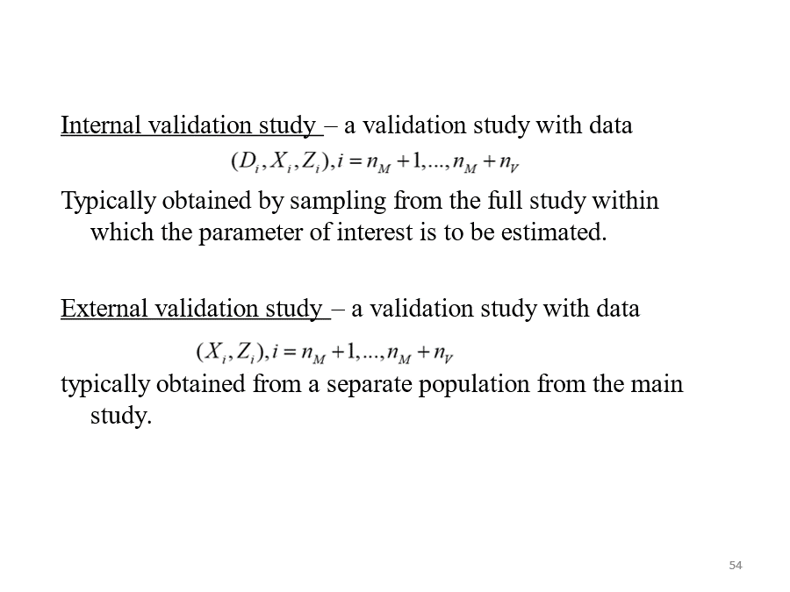
Validation Study

Slide 5
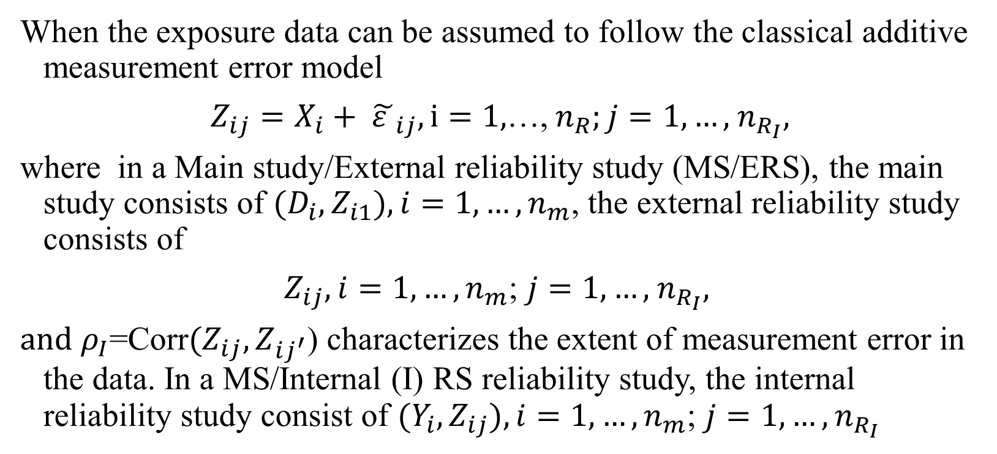
Reliability study
When the exposure data can be assumed to follow the classical additive measurement error model
$Z_{ij}=X_{i}+ {\tilde{ε }}_{ij}, i=1,$…, $n_{R};j=1,…,$ $n_{R_{I}},$
where in a Main study/External reliability study (MS/ERS), the main study consists of ${(D}_{i},Z_{i1}), i=1,…,n_{m}$, the external reliability study consists of
$Z_{ij}, i=1,…,n_{m}$; $j=1,…,$ $n_{R_{I}},$
$and ρ_{I}$=Corr${(Z}_{ij},Z_{ij^{′}}$) characterizes the extent of measurement error in the data. In a MS/Internal (I) RS reliability study, the internal reliability study consist of ${(Y_{i},Z}_{ij}), i=1,…,n_{m}$; $j=1,…,$ $n_{R_{I}}$

Slide 6


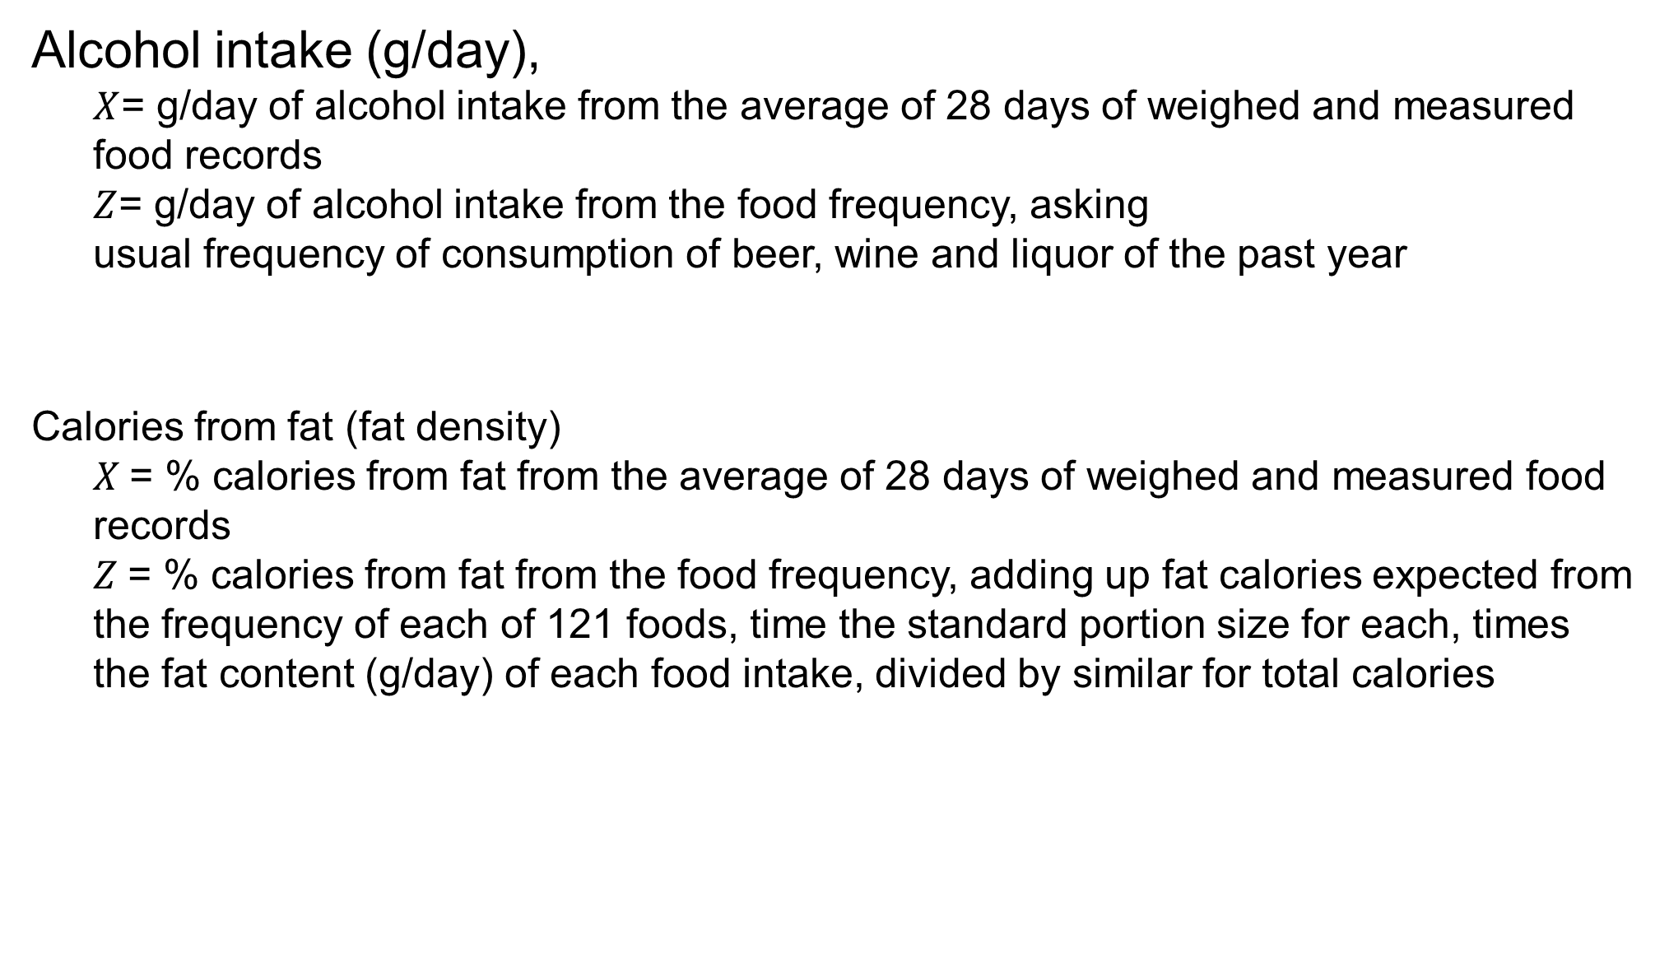
Empirical estimates of measurement error from Harvard’s Nurses’ Health Study validation study
Alcohol intake (g/day),
$X$= g/day of alcohol intake from the average of 28 days of weighed and measured food records
$Z$= g/day of alcohol intake from the food frequency, asking
usual frequency of consumption of beer, wine and liquor of the past year
Calories from fat (fat density)
$X$= % calories from fat from the average of 28 days of weighed and measured food records
$Z$= % calories from fat from the food frequency, adding up fat calories expected from the frequency of each of 121 foods, time the standard portion size for each, times the fat content (g/day) of each food intake, divided by similar for total calories
Willett et al, AJE, 1985

Slide 7
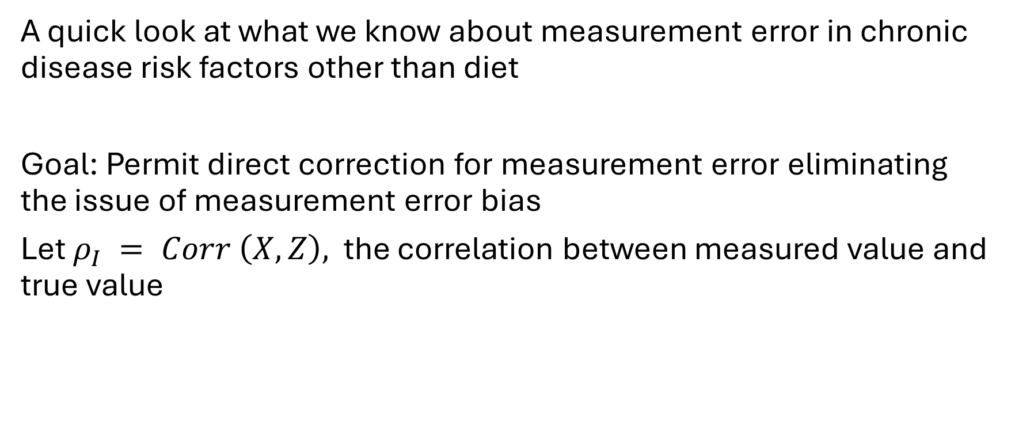
High quality validation and reliability data are available across a range of chronic disease risk factors, permitting empirical adjustment to eliminate this source of uncertainty
A quick look at what we know about measurement error in chronic disease risk factors other than diet
Goal: Permit direct correction for measurement error eliminating the issue of measurement error bias
Let $ρ_{I} = Corr \left(X,Z\right),$ the correlation between measured value and true value

Slide 8
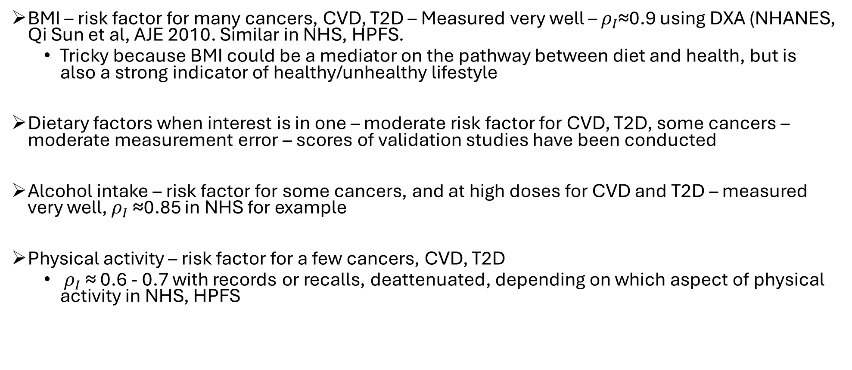
High quality validation and reliability data are available across a range of chronic disease risk factors, permitting empirical adjustment to eliminate this source of uncertainty
BMI – risk factor for many cancers, CVD, T2D – Measured very well – $ρ_{I}$≈0.9 using DXA (NHANES, Qi Sun et al, AJE 2010. Similar in NHS, HPFS.
Tricky because BMI could be a mediator on the pathway between diet and health, but is also a strong indicator of healthy/unhealthy lifestyle
Dietary factors when interest is in one – moderate risk factor for CVD, T2D, some cancers – moderate measurement error – scores of validation studies have been conducted
Alcohol intake – risk factor for some cancers, and at high doses for CVD and T2D – measured very well, $ρ_{I}$≈0.85 in NHS for example
Physical activity – risk factor for a few cancers, CVD, T2D
$ρ_{I}$≈ 0.6 - 0.7 with records or recalls, deattenuated, depending on which aspect of physical activity in NHS, HPFS

Slide 9
Epidemiologists have conducted hundreds of validation and reliability studies
[43]C. Yuan, D. Spiegelman, E. B. Rimm, B. A. Rosner, M. J. Stampfer, J. B. Barnett, J. E. Chavarro, J. C. Rood, L. J. Harnack, L. K. Sampson, and W. C. Willett. Relative Validity of Nutrient Intakes Assessed by Questionnaire, 24-Hour Recalls, and Diet Records as Compared With Urinary Recovery and Plasma Concentration Biomarkers: Findings for Women. American Journal of Epidemiology, 187(5):1051–1063, 2018. PMCID: PMC5928456.
[44]C. Yuan, D. Spiegelman, E. B. Rimm, B. A. Rosner, M. J. Stampfer, J. B. Barnett, J. E. Chavarro, A. F. Subar, L. K. Sampson, and W. C. Willett. Validity of a Dietary Questionnaire Assessed by Comparison With Multiple Weighed Dietary Records or 24-Hour Recalls. American Journal of Epidemiology, 185(7):570– 584, 2017. PMCID: PMC5859994.
[45]L. S. Freedman, J. M. Commins, W. C. Willett, L. F. Tinker, D. Spiegelman, D. Rhodes, N. Potischman, M. L. Neuhouser, A. J. Moshfegh, V. Kipnis, D. J. Baer, L. Arab, R. L. Prentice, and A. F. Subar. Evaluation of the 24-Hour Recall as a Reference Instrument for Calibrating Other Self-Report Instruments in Nutritional Cohort Studies: Evidence From the Validation Studies Pooling Project. American Journal of Epidemiology, 186(1):73–82, 2017. PMCID: PMC5703347.
[46]J. K. Bassett, D. R. English, M. T. Fahey, A. B. Forbes, L. C. Gurrin, J. A. Simpson, M. T. Brinkman, G. G. Giles, and A. M. Hodge. Validity and calibration of the FFQ used in the Melbourne Collaborative Cohort Study. Public Health Nutr, 19(13):2357–68, 2016.
[47]M. S. Buchowski, D. G. Schlundt, M. K. Hargreaves, J. H. Hankin, L. B. Signorello, and W. J. Blot. Devel- opment of a culturally sensitive food frequency questionnaire for use in the Southern Community Cohort Study. Cell Mol Biol (Noisy-le-grand), 49(8):1295–304, 2003.
[48]P. L. Carter-Nolan, L. L. Adams-Campbell, K. Makambi, S. Lewis, J. R. Palmer, and L. Rosenberg. Valida- tion of physical activity instruments: Black Women’s Health Study. Ethn Dis, 16(4):943–7, 2006.
[49]D. Feskanich, J. Marshall, E. B. Rimm, L. B. Litin, and W. C. Willett. Simulated validation of a brief food frequency questionnaire. Ann Epidemiol, 4(3):181–7, 1994.
[50]D. Feskanich, E. B. Rimm, E. L. Giovannucci, G. Colditz, M. Stampfer, L. Litin, and W. C. Willett. Repro- ducibility and validity of food intake measurements from a semiquantitative food frequency questionnaire. J Am Diet Assoc, 93(7):790–6, 1993.
[51]E. W. Flagg, R. J. Coates, E. E. Calle, N. Potischman, and M. J. Thun. Validation of the American Cancer Society Cancer Prevention Study II Nutrition Survey Cohort Food Frequency Questionnaire. Epidemiol- ogy, 11(4):462–8, 2000.
[52]R. A. Goldbohm, P. A. van den Brandt, H. A. Brants, P. van’t Veer, M. Al, F. Sturmans, and R. J. Hermus. Validation of a dietary questionnaire used in a large-scale prospective cohort study on diet and cancer. Eur J Clin Nutr, 48(4):253–65, 1994.
[53]J. H. Hankin, D. O. Stram, K. Arakawa, S. Park, S. H. Low, H. P. Lee, and M. C. Yu. Singapore Chinese Health Study: development, validation, and calibration of the quantitative food frequency questionnaire. Nutr Cancer, 39(2):187–95, 2001.
[54]P. L. Horn-Ross, V. S. Lee, C. N. Collins, S. L. Stewart, A. J. Canchola, M. M. Lee, P. Reynolds, C. A. Clarke,
L. Bernstein, and D. O. Stram. Dietary assessment in the California Teachers Study: reproducibility and validity. Cancer Causes Control, 19(6):595–603, 2008.
[55]M. G. Jain, L. Harrison, G. R. Howe, and A. B. Miller. Evaluation of a self-administered dietary question- naire for use in a cohort study. Am J Clin Nutr, 36(5):931–5, 1982.

Slide 10
Epidemiologists have conducted hundreds of validation and reliability studies
[69]F. E. Thompson, V. Kipnis, D. Midthune, L. S. Freedman, R. J. Carroll, A. F. Subar, C. C. Brown, M. S. Butcher, T. Mouw, M. Leitzmann, and A. Schatzkin. Performance of a food-frequency questionnaire in the US NIH-AARP (National Institutes of Health-American Association of Retired Persons) Diet and Health Study. Public Health Nutr, 11(2):183–95, 2008. PMID: 17610761.
[70]R. Villegas, G. Yang, D. Liu, Y. B. Xiang, H. Cai, W. Zheng, and X. O. Shu. Validity and reproducibility of the food-frequency questionnaire used in the Shanghai men’s health study. Br J Nutr, 97(5):993–1000, 2007.
[71]S. Chasan-Taber, E. B. Rimm, M. J. Stampfer, D. Spiegelman, G. A. Colditz, E. Giovannucci, A. Ascherio, and W. C. Willett. Reproducibility and validity of a self-administered physical activity questionnaire for male health professionals. Epidemiology, 7(1):81–6, 1996.
[72]D. Feskanich, E. B. Rimm, E. L. Giovannucci, G. Colditz, M. Stampfer, L. Litin, and W. C. Willett. Repro- ducibility and validity of food intake measurements from a semiquantitative food frequency questionnaire. J Am Diet Assoc, 93:790–796, 1993.
[73]E. B. Rimm, E. L. Giovannucci, M. J. Stampfer, G. A. Colditz, L. B. Litin, and W. C. Willett. Reproducibility and validity of an expanded self-administered semiquantitative food frequency questionnaire among male health professionals. Am J Epidemiol, 135(10):1114–26; discussion 1127–36, 1992.
[74]S. Salvini, D. Hunter, L. Sampson, M. Stampfer, G. Colditz, B. A. Rosner, and W. C. Willett. Food-based validation of a dietary questionnaire: the effects of week-to-week variation in food consumption. Int J Epidemiol, 18(4):858–867, 1989.
[75]W. C. Willett, L. Sampson, M. J. Stampfer, B. A. Rosner, C. Bain, J. Witschi, C. H. Hennekens, and F. E. Speizer. Reproducibility and validity of a semiquantitative food frequency questionnaire. Am J Epidemiol, 122:51–65, 1985.
[76]G. A. Colditz, M. J. Stampfer, W. C. Willett, W. B. Stason, B. A. Rosner, C. H. Hennekens, and F. E. Speizer. Reproducibility and validity of self-reported menopausal status in a prospective cohort study. Am J Epidemiol, 126(2):319–325, Aug 1987. PMID: 3605058.
[77]L. M. Troy, K. B. Michels, D. J. Hunter, D. Spiegelman, J. E. Manson, G. A. Colditz, M. J. Stampfer, and
W. C. Willett. Self-reported birthweight and history of having been breastfed among younger women: an assessment of validity. Int J Epidemiol, 25(1):122–7, Feb 1996. PMID: 8666479.
[78]D. J. Hunter, J. E. Manson, G. A. Colditz, L. Chasan-Taber, L. Troy, M. J. Stampfer, F. E. Speizer, and W. C. Willett. Reproducibility of oral contraceptive histories and validity of hormone composition reported in a cohort of US women. Contraception, 56(6):373–378, Dec 1997. PMID: 9494771.
[79]C. A. Tomeo, J. W. Rich-Edwards, K. B. Michels, C. S. Berkey, D. J. Hunter, A. L. Frazier, W. C. Willett, and S. L. Buka. Reproducibility and validity of maternal recall of pregnancy-related events. Epidemiology, 10(6):774–7, Nov 1999. PMID: 10535796.
[80]E. B. Rimm, M. J. Stampfer, G. A. Colditz, C. G. Chute, L. B. Litin, and W. C. Willett. Validity of self- reported waist and hip circumferences in men and women. Epidemiology, 1(6):466–473, Nov 1990. PMID: 2090285.
[81]L. M. Troy, D. J. Hunter, J. E. Manson, G. A. Colditz, M. J. Stampfer, and W. C. Willett. The validity of recalled weight among younger women. Int J Obes Relat Metab Disord, 19(8):570–572, Aug 1995. PMID: 7489028.

Slide 11
Epidemiologists have conducted hundreds of validation and reliability studies
[82]A. L. Frazier, W. C. Willett, and G. A. Colditz. Reproducibility of recall of adolescent diet: Nurses’ Health Study (United States). Cancer Causes Control, 6(6):499–506, Nov 1995. PMID: 8580297.
[83]C. Byrne, R. Sinha, E. A. Platz, E. Giovannucci, G. A. Colditz, D. J. Hunter, F. E. Speizer, and W. C. Willett. Predictors of dietary heterocyclic amine intake in three prospective cohorts. Cancer Epidemiol Biomarkers Prev, 7(6):523–529, Jun 1998. PMID: 9641497.
[84]I. Romieu, M. J. Stampfer, W. S. Stryker, M. Hernandez, L. Kaplan, A. Sober, B. A. Rosner, and W. C. Willett. Food predictors of plasma beta-carotene and alpha-tocopherol: validation of a food frequency questionnaire. Am J Epidemiol, 131(5):864–876, May 1990. PMID: 2321629.
[85]M. Garland, F. M. Sacks, G. A. Colditz, E. B. Rimm, L. A. Sampson, W. C. Willett, and D. J. Hunter. The relation between dietary intake and adipose tissue composition of selected fatty acids in US women. Am J Clin Nutr, 67(1):25–30, 1998.
[86]A. Wolf, D. Hunter, G. Colditz, J. Manson, M. Stampfer, K. Corsano, B. A. Rosner, A. Kriska, and W. C. Willett. Reproducibility and validity of a self-administered physical activity questionnaire. Int J Epidemiol, 23(5):991–999, 1994.
[87]C. E. Matthews, S. K. Keadle, S. C. Moore, D. S. Schoeller, R. J. Carroll, R. P. Troiano, and J. N. Sampson. Measurement of Active and Sedentary Behavior in Context of Large Epidemiologic Studies. Medicine & Science in Sports & Exercise, 50(2):266–276, 2018. PMCID: PMC5768470.
[88]C. E. Matthews, S. K. Keadle, P. F. Saint-Maurice, S. C. Moore, E. A. Willis, J. N. Sampson, and D. Berrigan. Use of Time and Energy on Exercise, Prolonged TV Viewing, and Work Days. American Journal of Preventive Medicine, 55(3):e61 – e69, 2018.
[89]A. K. Chomistek, C. Yuan, C. E. Matthews, R. P. Troiano, H. R. Bowles, J. Rood, J. B. Barnett, W. C. Willett,
E. B. Rimm, and D. R. Bassett. Physical Activity Assessment with the ActiGraph GT3X and Doubly Labeled Water. Medicine and science in sports and exercise, 49(9):1935–1944, 2017. PMCID: PMC5561512.

Slide 12
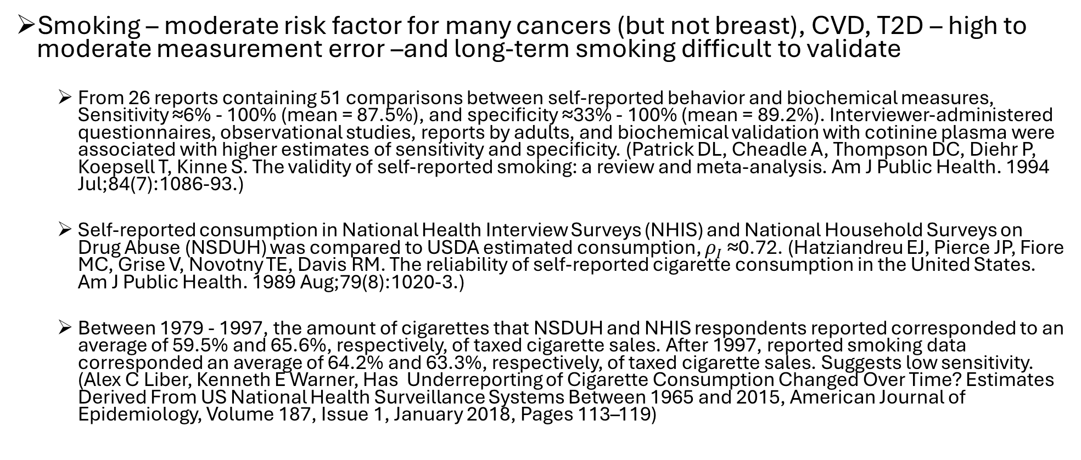
High quality validation and reliability data are available across a range of chronic disease risk factors, permitting empirical adjustment to eliminate this source of uncertainty
Smoking – moderate risk factor for many cancers (but not breast), CVD, T2D – high to moderate measurement error –and long-term smoking difficult to validate
From 26 reports containing 51 comparisons between self-reported behavior and biochemical measures, Sensitivity ≈6% - 100% (mean = 87.5%), and specificity ≈33% - 100% (mean = 89.2%). Interviewer-administered questionnaires, observational studies, reports by adults, and biochemical validation with cotinine plasma were associated with higher estimates of sensitivity and specificity. (Patrick DL, Cheadle A, Thompson DC, Diehr P, Koepsell T, Kinne S. The validity of self-reported smoking: a review and meta-analysis. Am J Public Health. 1994 Jul;84(7):1086-93.)
Self-reported consumption in National Health Interview Surveys (NHIS) and National Household Surveys on Drug Abuse (NSDUH) was compared to USDA estimated consumption, $ρ_{I}$≈0.72. (Hatziandreu EJ, Pierce JP, Fiore MC, Grise V, Novotny TE, Davis RM. The reliability of self-reported cigarette consumption in the United States. Am J Public Health. 1989 Aug;79(8):1020-3.)
Between 1979 - 1997, the amount of cigarettes that NSDUH and NHIS respondents reported corresponded to an average of 59.5% and 65.6%, respectively, of taxed cigarette sales. After 1997, reported smoking data corresponded an average of 64.2% and 63.3%, respectively, of taxed cigarette sales. Suggests low sensitivity. (Alex C Liber, Kenneth E Warner, Has Underreporting of Cigarette Consumption Changed Over Time? Estimates Derived From US National Health Surveillance Systems Between 1965 and 2015, American Journal of Epidemiology, Volume 187, Issue 1, January 2018, Pages 113–119)

Slide 13
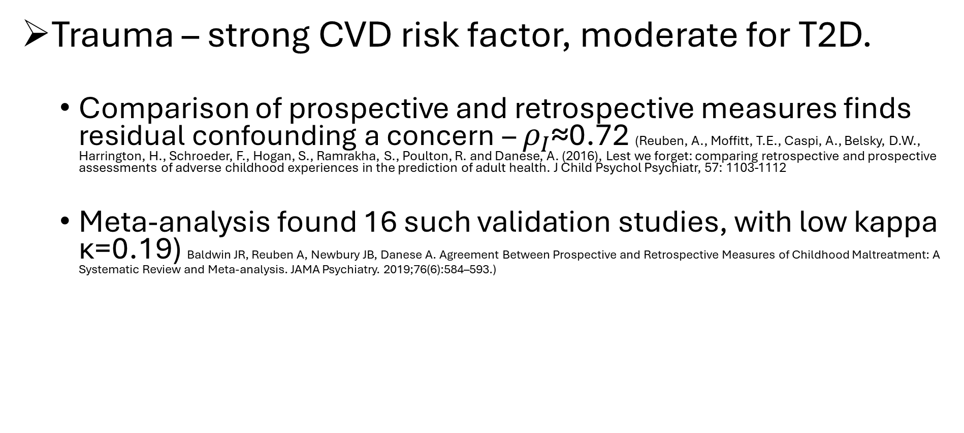
High quality validation and reliability data are available across a range of chronic disease risk factors, permitting empirical adjustment to eliminate this source of uncertainty
Trauma – strong CVD risk factor, moderate for T2D.
Comparison of prospective and retrospective measures finds residual confounding a concern – $ρ_{I}$≈0.72 (Reuben, A., Moffitt, T.E., Caspi, A., Belsky, D.W., Harrington, H., Schroeder, F., Hogan, S., Ramrakha, S., Poulton, R. and Danese, A. (2016), Lest we forget: comparing retrospective and prospective assessments of adverse childhood experiences in the prediction of adult health. J Child Psychol Psychiatr, 57: 1103-1112
Meta-analysis found 16 such validation studies, with low kappa κ=0.19) Baldwin JR, Reuben A, Newbury JB, Danese A. Agreement Between Prospective and Retrospective Measures of Childhood Maltreatment: A Systematic Review and Meta-analysis. JAMA Psychiatry. 2019;76(6):584–593.)

Slide 14
High quality validation and reliability data are available across a range of chronic disease risk factors, permitting empirical adjustment to eliminate this source of uncertainty
Regular high quality preventive health care – strong risk factor for CRC, not breast, for CVD, T2D
The sensitivity of self-reported screening was 96.2% for the FOBT, 94.9% for flexible sigmoidoscopy, 88.7% for colonoscopy, and 96.2% for either endoscopic screening test.
The specificity of self-reported screening was 85.9%for the FOBT, 92.2% for flexible sigmoidoscopy, 96.8%for colonoscopy, and 92.0% for either endoscopic screening test. (Baier M, Calonge N, Cutter G, McClatchey M, Schoentgen S, Hines S, Marcus A, Ahnen D. Validity of self-reported colorectal cancer screening behavior. Cancer Epidemiol Biomarkers Prev. 2000 Feb;9(2):229-32. )

Slide 15
To what extent do trials resolve problems?
Intent to treat estimates are biased towards the null by random non-adherence, and bias could be in either direction due to non-random non-adherence
‘As treated’ and ‘per protocol’ estimates can be biased by confounding and selection bias, respectively, just as in an observational study
No bias in p-values for random non-adherence
Trials of sustained dietary intakes likely suffer from substantial non-adherence
Empirical methods to correct for bias due to non-adherence are not as well developed, particularly for random non-adherence

Slide 16
Empirical correction for measurement error in exposures and confounders
Good news:
– with these validation or reliability data, hundreds of publications provide a robust, flexible set of methods to empirically correct for measurement error in exposures of interest and confounders simultaneously.

Slide 17
Empirical correction for measurement error in exposures and confounders
Seminal textbook and scores of papers by Ray Carroll and colleagues
Carroll, R.J., Ruppert, D., Stefanski, L.A., & Crainiceanu, C.M. (2006). Measurement Error in Nonlinear Models: A Modern Perspective, Second Edition (2nd ed.). Chapman and Hall/CRC. https://doi.org/10.1201/9781420010138
Three key papers from the Harvard/Yale group:
Rosner, B., Willett, W.C. and Spiegelman, D. (1989), Correction of logistic regression relative risk estimates and confidence intervals for systematic within-person measurement error. Statist. Med., 8: 1051-1069.
Rosner B, Spiegelman D, Willett WC. Correction of logistic regression relative risk estimates and confidence intervals for measurement error: the case of multiple covariates measured with error. Am J Epidemiol. 1990 Oct;132(4):734-45.
Rosner B, Spiegelman D, Willett WC. Correction of logistic regression relative risk estimates and confidence intervals for random within-person measurement error. Am J Epidemiol. 1992
1088 citations as of early 2025, 73% of citations in non-statistical journals
Other work covers survival data analysis, population attributable risks, principles of modeling, design of MS/VS, misclassification, risk prediction, changepoint analysis, and a wide range of other topics.
Software available here https://ysph.yale.edu/cmips/research/software/

Slide 18
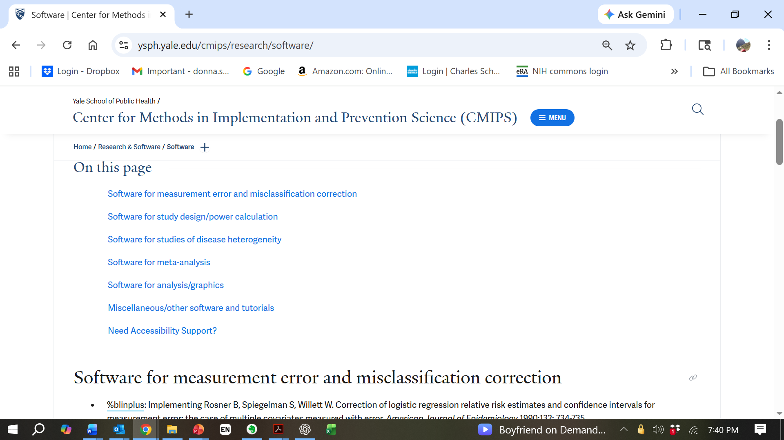



Slide 19
